Slide 1



Title: Implementation of Chatbot using NLP
Developed a chatbot that answers basic questions
Github project repository link: https://github.com/ajay041100/chatbtot_project

Slide 2

Learning Objectives
Understand NLP-based chatbot development
Learn TF-IDF vectorization for text processing
Implement Cosine Similarity for response selection
Build a web-based chatbot using Streamlit
GOAL

Slide 3
Goal
To develop a lightweight, web-based chatbot
Uses TF-IDF and Cosine Similarity for intelligent responses
Enables users to ask questions and receive accurate answers in a browser

Slide 4
Tools and Technology used
Python (Programming Language)
Streamlit (Web UI Framework)
Scikit-learn (TF-IDF & Cosine Similarity)
NLTK (Natural Language Toolkit for text preprocessing)

Slide 5
Problem Statement:
Traditional chatbots require large datasets & complex AI training
Rule-based chatbots lack flexibility in understanding user input
Need a lightweight chatbot that provides accurate responses using NLP techniques

Slide 6
Solution:
A chatbot that processes user queries using TF-IDF & Cosine Similarity
Loads predefined Q&A from intents.json
Displays chatbot interaction in a web-based UI (Streamlit)

Slide 7
Methodology
Load predefined questions & answers from intents.json
Preprocess text (lowercasing, punctuation removal)
Convert text into numerical form using TF-IDF
Compute Cosine Similarity to find the closest match
Display chatbot conversation in Streamlit UI

Slide 8
Implementation
Loads Q&A from intents.json
Uses TF-IDF to process text queries
Cosine Similarity selects the best response
Chat history is stored using Streamlit session state

Slide 9
Features
✔ Web-based chatbot UI (Streamlit) ✔ Predefined knowledge base (AI, Python, and more) ✔ TF-IDF & Cosine Similarity for accurate response selection ✔ Chat history retention using Streamlit session state

Slide 10
TF-IDF Explanation
TF-IDF (Term Frequency-Inverse Document Frequency) is used to determine the importance of words in a document
Helps the chatbot prioritize important words in a query
Ensures more relevant responses based on keyword importance

Slide 11
Cosine Similarity
Measures how similar two text vectors are
Helps chatbot find the closest matching question in the dataset
Used to select the best response

Slide 12
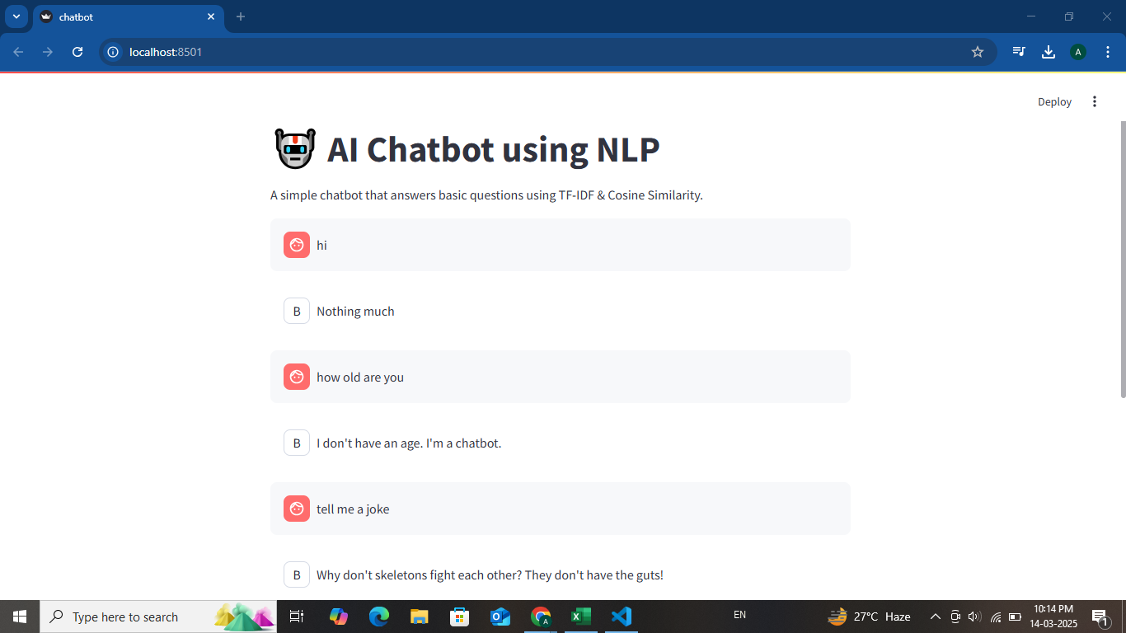
Screenshot of Output:

Slide 13
Future Enhancements
🚀 Integrate Speech-to-Text for voice-based chatbot interaction 🚀 Expand knowledge base with more topics 🚀 Deploy chatbot on a cloud server for public access

Slide 14
Conclusion
Successfully built an NLP-based chatbot with a web-friendly interface
Uses TF-IDF & Cosine Similarity for accurate response selection
Lightweight & efficient chatbot without external APIs

